Slide 1
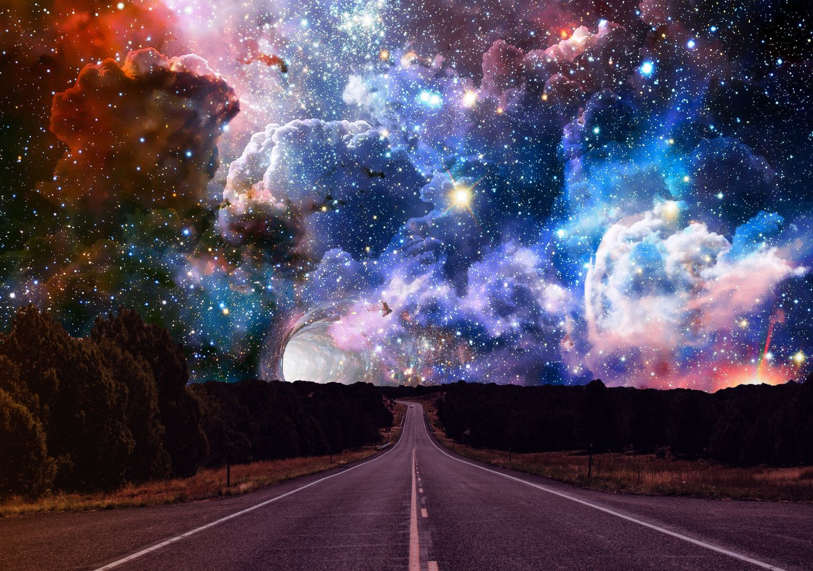
AI for the Environment Hackathon Festival
Pitch deck template

Slide 2
CONNECT
30 seconds
Connect with your audience
Think of it like speed dating – you have 30 seconds to make your first impression – and that first impression could change your life (and everyone else’s) FOREVER
Who are you and what is your passion?
‹#›

Slide 3
PROBLEM TO SOLVE
1
minute
What is the problem you are trying to solve? and
Why should I care?
Who or what does it impact?
Humanise it – Create empathy for the creatures (human or otherwise) impacted
Use a short story and KILLER DATA (this is an AI Hack after all)
Make sure you describe the problem you are solving
(not necessarily the one that you set out to solve)
‹#›

Slide 4
YOUR BIG IDEA
2
minutes
Explain your innovation
How does it solve the problem?
AND how does your innovation meet the brief?
Show us your prototype (High Fidelity or Click-through slideware)
‹#›

Slide 5
FUTURE IMPACT
1.5
minutes
IMPACT
What will your innovation change?
Be compelling - Why should I care?
WHAT DO YOU NEED?
What do you need to make this work?
FUTURE
What could this mean for the future? (FOR OUR FUTURE?)
‹#›

Slide 6
AI for the Environment Hackathon Festival
Stay up to date with the latest information: www.aihackathon.nz

